Slide 1

Let’s training?
Exercise 1 - Given an IDS dataset (Zeek), perform the follows task:
As the dataset has a big size, generate a random sample (10% of original dataset) to be possible to analyze.
Convert the ts field (timestamp) to the correct format (datetime64)
Display the unique ports and originator Ips.
(bonus points for the number of connections of each) associated with all HTTP connections NOT over port 80.

Slide 2


What is Bro (Zeek)?
Zeek (formerly Bro) is a passive, open-source network traffic analyzer.
It is primarily a security monitor that inspects all traffic on a link in depth for signs of suspicious activity.
More generally, however, Zeek supports a wide range of traffic analysis tasks even outside of the security domain, including performance measurements and helping with trouble-shooting.

Slide 3
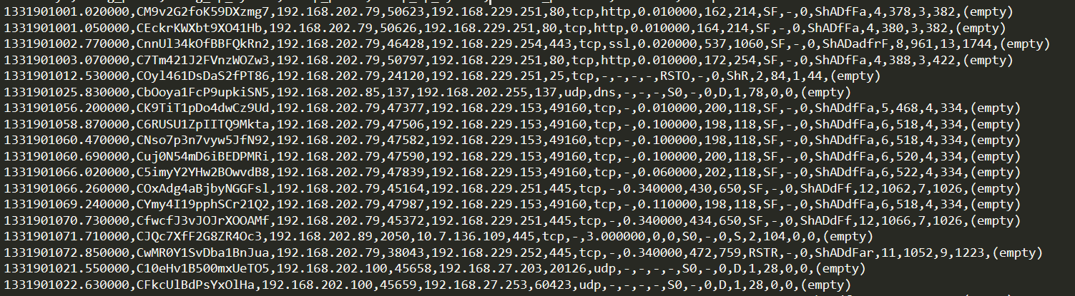
Understanding the dataset
ts = 1331901001.020000 uid=CM9v2G2foK59DXzmg7 id.orig_h=192.168.202.79 id.orig_p=50623 id.resp_h=192.168.229.251 id.resp_p=80 proto=tcp service=http duration=0.010000 orig_bytes=162 resp_bytes=214 conn_state=SF local_orig=- missed_bytes=0 history=ShADfFa orig_pkts=4 orig_ip_bytes=378 resp_pkts=3 resp_ip_bytes=382 tunnel_parents=(empty) threat sample
The dataset is a log file generated from Bro (like netflow logs).

Slide 4

https://www.shanelynn.ie/select-pandas-dataframe-rows-and-columns-using-iloc-loc-and-ix/
https://pandas.pydata.org/pandas-docs/stable/reference/api/pandas.DataFrame.groupby.html

Slide 5
Answer - Generating a Sample
def generate_sample(logfile, outfile): import random sample_percent = .01 num_lines = sum(1 for line in open(logfile)) slines = set(sorted(random.sample(range(num_lines), int(num_lines * sample_percent)))) print ("%s lines in %s, using a sample of %s lines" %(num_lines, logfile, len(slines))) f = open(outfile, 'w+') i = open(logfile, 'r+') linecount = 0 for line in i: if linecount in slines: f.write(line) linecount += 1 f.close() i.close()
Define the size of sample (10%)

Slide 6
Answer - Generating a Sample
def generate_sample(logfile, outfile): import random sample_percent = .01 num_lines = sum(1 for line in open(logfile)) slines = set(sorted(random.sample(range(num_lines), int(num_lines * sample_percent)))) print ("%s lines in %s, using a sample of %s lines" %(num_lines, logfile, len(slines))) f = open(outfile, 'w+') i = open(logfile, 'r+') linecount = 0 for line in i: if linecount in slines: f.write(line) linecount += 1 f.close() i.close()
slines is the array that defines the sample.
To decrease the bias, the selected line is defined randomly.

Slide 7
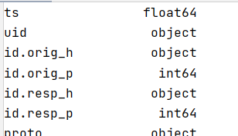
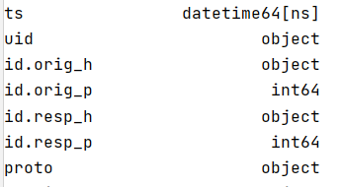
Answer – Convert datatype
from datetime import datetime conn_df['ts'] = [ datetime.fromtimestamp(float(date)) for date in conn_df['ts'].values ] print(conn_df.dtypes)
convert the ts attribute to more convenient format
long(timestamp) –> date
Sometimes the field type is not useful or has some performance issues to the be manipulated.
Ex.: timestamp

Slide 8
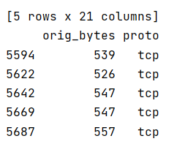
Pandas Basic Operations
#remove a column conn_df.drop('threat', axis=1, inplace=True) print(conn_df.dtypes) #Row Selection¶ print(conn_df[conn_df['service'] == 'ssl'].head()) #get the lines where service is == ssl and over ports other than 443. ssl_df = conn_df[conn_df['service'] == 'ssl'] print(ssl_df[ssl_df['id.resp_p'] == 443][['orig_bytes','proto']].head())
Select the first (head) 5 rows where service is equal ssl and id.resp_p !=443 but presents only the follows fields: orig_bytes and proto.

Slide 9
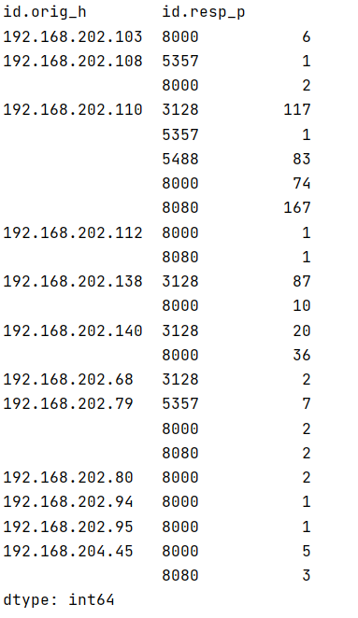

Answer – Get the information
#create a new dataset with only registers where service == http and proto !=80 orig_ip_ds = conn_df.loc[(conn_df.service == 'http') & (conn_df.id_resp_p != 80)] #display the number of repetitions of each set port/ip has orig_ip_ds = orig_ip_ds.groupby(['id_orig_h', 'id_resp_p']).size() print(orig_ip_ds)

Slide 10

Data Summarization

Slide 11

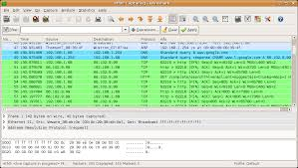
PCAP
PCAP (packet capture) is an application programming interface (API) for capturing network traffic.
Wireshark is a free and open-source packet analyzer. It is used for network troubleshooting, analysis, software and communications protocol development, and education.
Wireshark supports a bunch of export formats, including pcap.
Wireshark has a set of features that simplifies the analysis of a specific stream of data, having protocols plugins that enable analyst to read the information contextualized with the protocol.

Slide 12

Understanding the Dataset (http.log)
The data was generated from various PCAPs that have been collected and contain both legitimate traffic as well as traffic relating to exploit kits.
While no malicious traffic is contained within the log file there are malicious domains and URLS (it's recommended you don't visit them).
While this traffic was generated by running Bro over a series of PCAPS, similar data can be obtained from various Web Proxies, this is a nice cross over example of what is possible with your own data.

Slide 13

Training, Training, …
Using the techniques previous learned, prepare the log file (http.log) to be used to pandas framework.
The fields are: 'ts', 'uid', ‘id_orig_h', ‘id_orig_p', ‘id_resp_h', ‘id_resp_p', 'trans_depth', 'method', 'host', 'uri', 'referrer', 'user_agent', 'request_body_len', 'response_body_len', 'status_code', 'status_msg', 'info_code', 'info_msg', 'filename', 'tags', 'username', 'password', 'proxied', 'orig_fuids', 'orig_mime_types', 'resp_fuids', 'resp_mime_types', 'sample’.
15 min

Slide 14

Solution
######## PART I - DATA PREPARATION ######################### import pandas as pd import data_utils as utils http_df = pd.read_csv("resources/http.log", sep="\t", header=None, names=['ts', 'uid', 'id_orig_h', 'id_orig_p', 'id_resp_h', 'id_resp_p', 'trans_depth', 'method', 'host', 'uri', 'referrer', 'user_agent', 'request_body_len', 'response_body_len', 'status_code', 'status_msg', 'info_code', 'info_msg', 'filename', 'tags', 'username', 'password', 'proxied', 'orig_fuids', 'orig_mime_types', 'resp_fuids', 'resp_mime_types', 'sample']) print(http_df.head())

Slide 15
Timestamp in Network Analysis
Everything happening on the network is time sensitive.
This feature can not only prevent and analyze cyberattacks, but it can also allow you to examine trends and network latency.
Network packet timestamping can be used to investigate various events that, one way or another, have affected your network performance.
For instance, tracing the arrival of packets gives you an idea about the original traffic, so that you can calculate perlink metrics, like utilization figures, or performance of applications, such as TCP flow throughput, delay, and jitter.
Incorrectly timed packets will cause a delay in identifying and resolving the issues, which makes timestamping essential.
Timestamp in distributed sensors network can be used to correlate events.

Slide 16
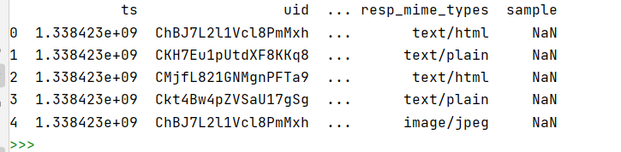
Time Series Analysis
The first step in the analysis is to study the dataset's structure and see some values, looking to understand it better.
print(http_df.head()) print(http_df.shape) print(http_df.info())

Slide 17
Time Series Analysis
The first step in the analysis is to study the dataset's structure and see some values, looking to understand it better.
print(http_df.head()) print(http_df.shape) print(http_df.info())
(807537, 28)
Number of columns (attributes)
Number of lines

Slide 18
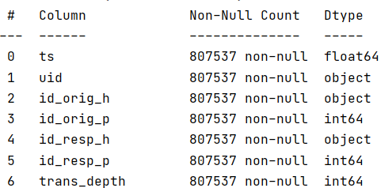
Time Series Analysis
The first step in the analysis is to study the dataset's structure and see some values, looking to understand it better.
print(http_df.head()) print(http_df.shape) print(http_df.info())

Slide 19
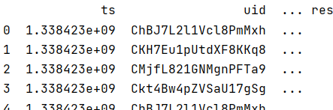
Time Series Analysis
Perceive the timestamp field (ts) has a float type.
During a time series analysis, the first task is looking for information in the dataset, trying to reassemble slice times of unusual or dangerous activities.
If the timestamp is in the float format, the analyst needs, first, to translate it to date format to create the required queries to analyze the dataset and understand how these activities happened.

Slide 20

Training, Training, Training ….
Using the content learned in the first part of training, convert the timeframe to the date format.
15 min

Slide 21
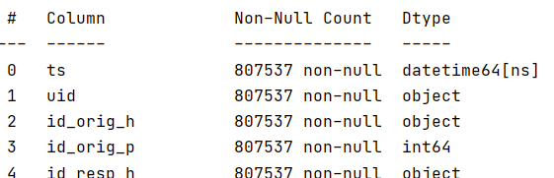
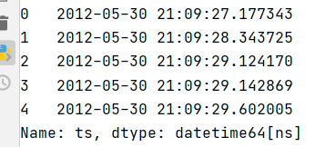

Solution
from datetime import datetime http_df['ts'] = [ datetime.fromtimestamp(float(date)) for date in http_df['ts'].values ] print(http_df.info()) print(http_df.ts.head())

Slide 22
Analyze the dataset
Analyzing the dataset, perceives that it is indexed by the row number.
To perform time series analyzes, it is required that dataset is indexed by the timestamp.

Slide 23
Analyze the dataset
Index dataset by ts
http_df = http_df.set_index('ts') http_df.index = pd.to_datetime(http_df.index) http_df = http_df.sort_index() print(http_df.head())
Set index to type of 'DatetimeIndex',
Re-sort the dataset

Slide 24
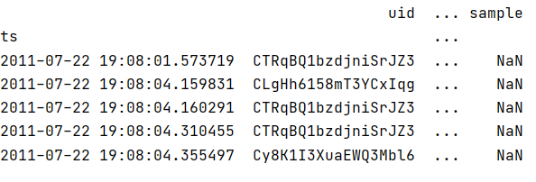
Analyze the dataset
http_df = http_df.set_index('ts') http_df.index = pd.to_datetime(http_df.index) http_df = http_df.sort_index() print(http_df.head())

Slide 25
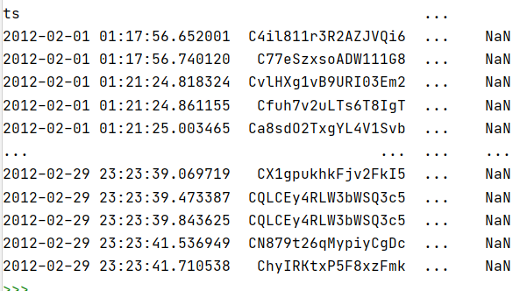
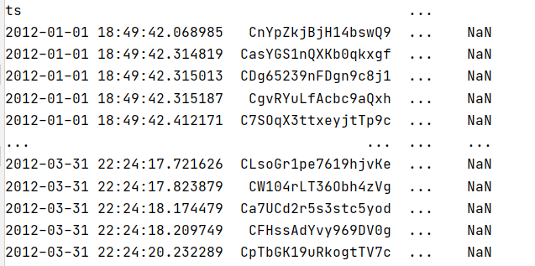
Perform some queries
print(http_df['2012-02']) # select the given month print(http_df['2012-01':'2012-03']) # select between dates

Slide 26
Install Support Libraries
Python and Pandas has some methods to convert strings into timestamp; however, these methods are inefficient and has a very complex syntax.
An alternative is the use of ciso8601 library, which implements the ISO 8601 or RFC 3339.
However, it requires some system operation compile libraries to install it.

Slide 27
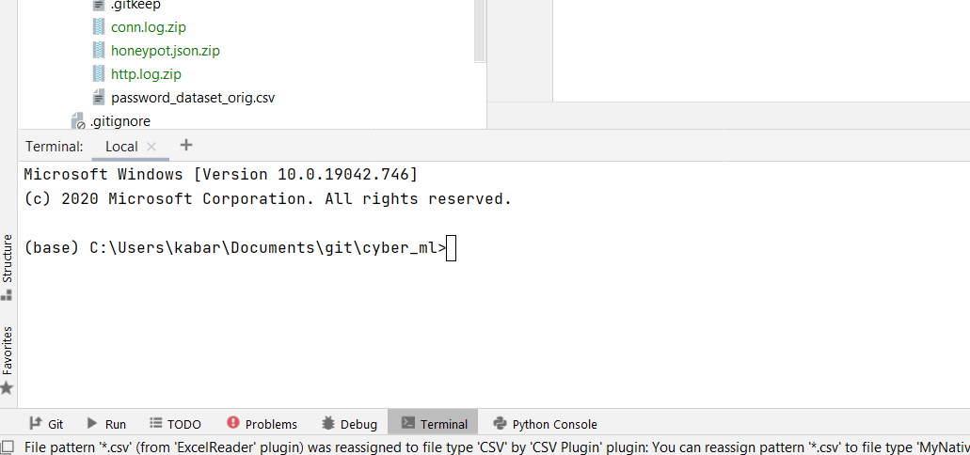

Install Support Libraries
Compilation error message

Slide 28

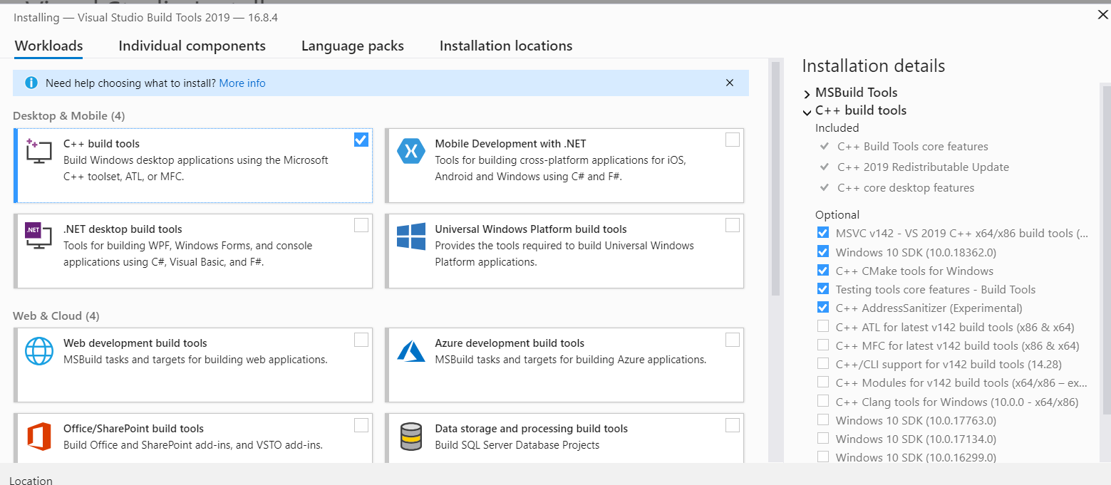
Install Support Libraries

Slide 29
Convert Date (String) to Timestamp
#convert data_str to timestamp dt1 = "20120110" #2012-01-10 ts1 = utils.convert_date_ts(dt1) dt2 = "20120220" #2012-02-20 ts2 = utils.convert_date_ts(dt2)
def convert_date_ts(date_str): import ciso8601 import time date = ciso8601.parse_datetime(date_str) ts = time.mktime(date.timetuple()) return ts
dthr1="20120110T123045" #2012-01-10 12:30:45 ts_dthr1 = utils.convert_date_ts(dthr1) dthr2 = "20120220T123045" #2012-02-20 12:30:45 ts_dthr2 = utils.convert_date_ts(dthr2)

Slide 30
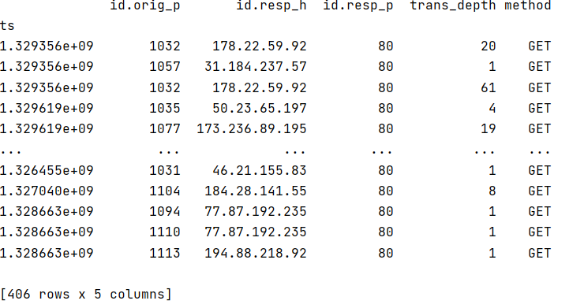
Time Based Queries
#convert data_str to timestamp dt1 = "20120110" #2012-01-10 ts1 = utils.convert_date_ts(dt1) dt2 = "20120220" #2012-02-20 ts2 = utils.convert_date_ts(dt2) #get the information between the interval 20120110 - 20120220 values = http_df.loc[(http_df.index>ts1) &(http_df.index<ts2)] #print only the column 2 to 7 print(values[http_df.columns.tolist()[2:7]].head())

Slide 31
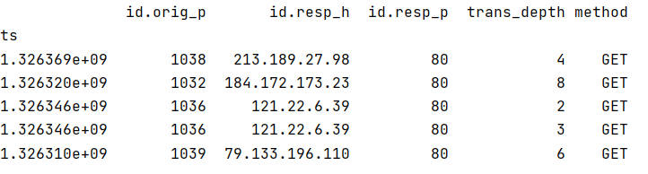
Time Based Queries
dthr1="20120110T123045" #2012-01-10 12:30:45 ts_dthr1 = utils.convert_date_ts(dthr1) dthr2 = "20120112T173045" #2012-01-12 17:30:45 ts_dthr2 = utils.convert_date_ts(dthr2) #get the information between the interval 20120110 12:30:45 - 20120220 12:30:45 values = http_df.loc[(http_df.index>ts_dthr1) &(http_df.index<ts_dthr2)] print(values[http_df.columns.tolist()[2:7]])
Only 5 registers

Slide 32
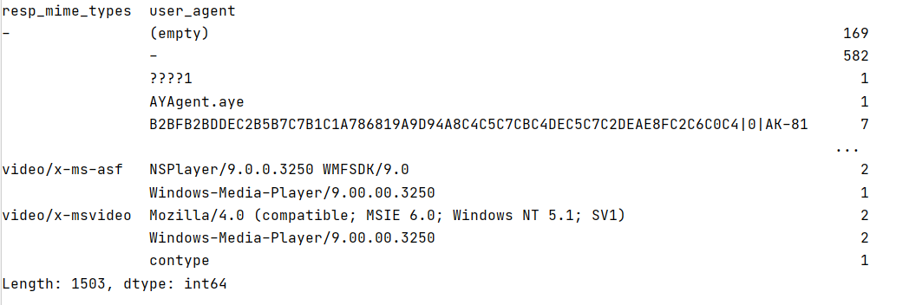
Grouping Data
Group the data base in some restriction passed by the user.
how many entries are in the data per-user-agent per-filetype.
print(http_df.groupby(['resp_mime_types','user_agent']).size())

Slide 33
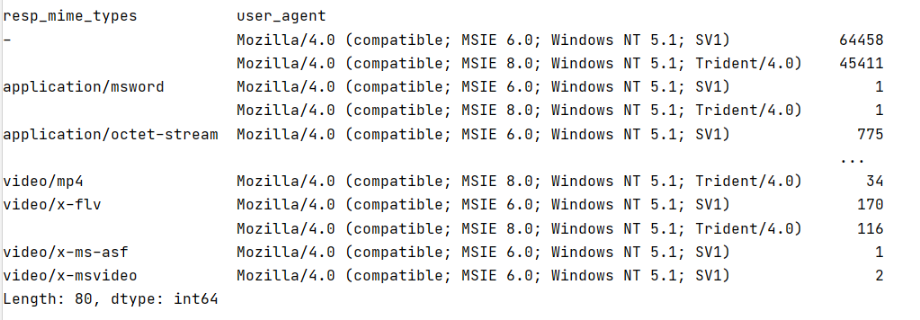
Using the isin function
Check if exist any values in the ‘user_agent’ field that is inside the set passed by the user (parameters).
After it group the information to present to the user.
print(http_df[http_df['user_agent'].isin( ['Mozilla/4.0 (compatible; MSIE 6.0; Windows NT 5.1; SV1)', 'Mozilla/4.0 (compatible; MSIE 8.0; Windows NT 5.1; Trident/4.0)'])].groupby(['resp_mime_types','user_agent']).size())

Slide 34
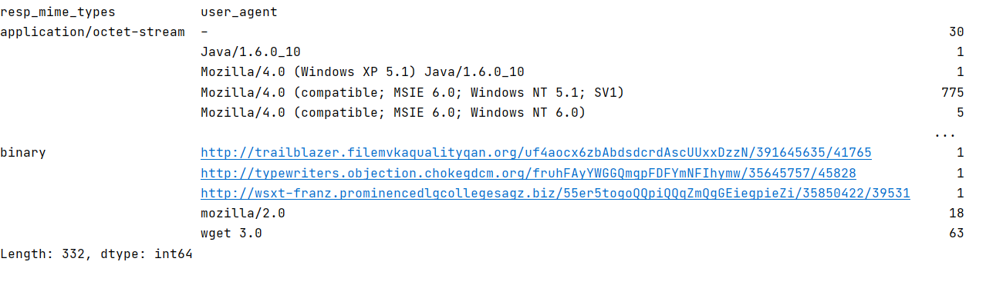
Using the isin function
executable_types = set(['application/x-dosexec', 'application/octet-stream', 'binary', 'application/vnd.ms-cab-compressed']) common_exploit_types = set(['application/x-java-applet','application/pdf','application/zip','application/jar','application/x-shockwave-flash']) print(http_df[http_df['resp_mime_types'].isin(executable_types)].groupby(['resp_mime_types','user_agent']).size())
Define a set of values to be used in the search using isin function

Slide 35
Training, Training, …
Converting the field ts of dataset to be stored in DATE (string) format.
20 min

Slide 36
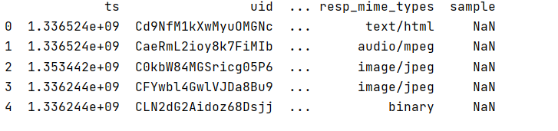
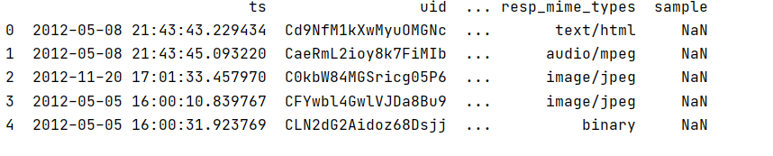
Training, Training, …
Original dataset
Target dataset

Slide 37
Solution
def convert_ts_to_date(df): from datetime import datetime i =0 for index, row in df.iterrows(): line = row ts = line["ts"] # print(ts) date = datetime.fromtimestamp(ts) df.at[i, "ts"] = date i=i+1 return df

